Slide 1

ENRICHING
ANALYTICS WITH
GEOGRAPHIC DATA SCIENCE
DANI ARRIBAS-BEL
LEVI JOHN WOLF
@darribas
@levijohnwolf
geographicdata.science/book

Slide 2
CONCEPTS COMPUTATION

Slide 3
CONCEPTS COMPUTATION

Slide 4
NOT
EVERYONE
DOES
GEOGRAPHY

Slide 5
EVERYBODY
CAN BE A
GEOGRAPHER

Slide 6
GEOGRAPHY

Slide 7
GEOGRAPHY
IS WHAT
GEOGRAPHERS DO
Apocryphal, attributed to Wilson (1970),
also earlier by Johston & Sidaway (2015)

Slide 8
GEOGRAPHY
IS WHAT
GEOGRAPHERS DO
¯\_(ツ)_/¯
Apocryphal, attributed to Wilson (1970),
also earlier by Johston & Sidaway (2015)

Slide 9
GEOGRAPHY
the systematic study
of relationships
between people
and their environments.

Slide 10
GEOGRAPHY
commuting, segregation, climate change, urban planning, campaigns, elections, and voting,
housing markets, energy forecasting, operational research, conservation, community dynamics,
disease spread, violent conflict, school efficacy, ecology, economic development, ice sheets, rugby
digital economy, program evaluation, migration, natural hazards risk, social vulnerability, trade

Slide 11
GEOGRAPHERS
use the relationships
between people and
their environments
to solve problems

Slide 12
NOT
EVERYONE
DOES
GEOGRAPHY

Slide 13
EVERYBODY
CAN BE A
GEOGRAPHER

Slide 14

NYT: ONE NATION TRACKED
https://nyti.ms/2uwMIUZ

Slide 15
Every minute of every day, everywhere on the planet dozens of companies are logging the movements of tens of millions of people.
[…]
Without much effort we spotted visitors to the estates of Johnny Depp, Tiger Woods and Arnold Schwarzenegger, connecting the devices’ owners to the residences.
NYT: ONE NATION TRACKED
https://nyti.ms/2uwMIUZ

Slide 16
UBIQUITY
Everything has a geographical location & time of occurrence
Every minute of every day, everywhere on the planet dozens of companies are logging the movements of tens of millions of people.
Without much effort we spotted visitors to the estates of Johnny Depp, Tiger Woods and Arnold Schwarzenegger, connecting the devices’ owners to the residences.
CONTEXT
Location enhances information
that is already available

Slide 17
Everything has a geographical location & time of occurrence

Slide 18
Everything has a geographical location & time of occurrence
Every Monday without fail, a final-year undergrad knocks on my door at 17:55, right as I’m packing up to leave my office, to ask if they can meet to talk about their dissertation.

Slide 19
Everything has a geographical location & time of occurrence
Event E happens

Slide 20
Everything has a geographical location & time of occurrence
Event E happens
at 17:55
every Monday
as I pack up to leave
occurrence

Slide 21
Everything has a geographical location & time of occurrence
Event E happens
at 17:55
every Monday
as I pack up to leave
occurrence
periodicity

Slide 22
Everything has a geographical location & time of occurrence
Event E happens
at 17:55
every Monday
as I pack up to leave
occurrence
periodicity
causality

Slide 23
Everything has a geographical location & time of occurrence
Event E happens
at 17:55
every Monday
as I pack up to leave
occurrence
periodicity
causality
(G-)

Slide 24
Everything has a geographical location & time of occurrence
Event E happens
at 17:55
every Monday
as I pack up to leave
TIME: MORE THAN CLOCK POSITION
occurrence
periodicity
causality
(G-)

Slide 25
Everything has a geographical location & time of occurrence
Event E happens
at 51°27'N 2°35'W
in Bristol
near me
location
relation
contagion
SPACE: MORE THAN EARTH POSITION

Slide 26

PYTHON FOR
GEOGRAPHIC
DATA ANALYSIS
Henrikki Tenkanen
Vuokko Heikinheimo
David Whipp
Solving Geographic Information Processing problems
with high-performance Python. CRC Press, 202X.
pythongis.org

Slide 27
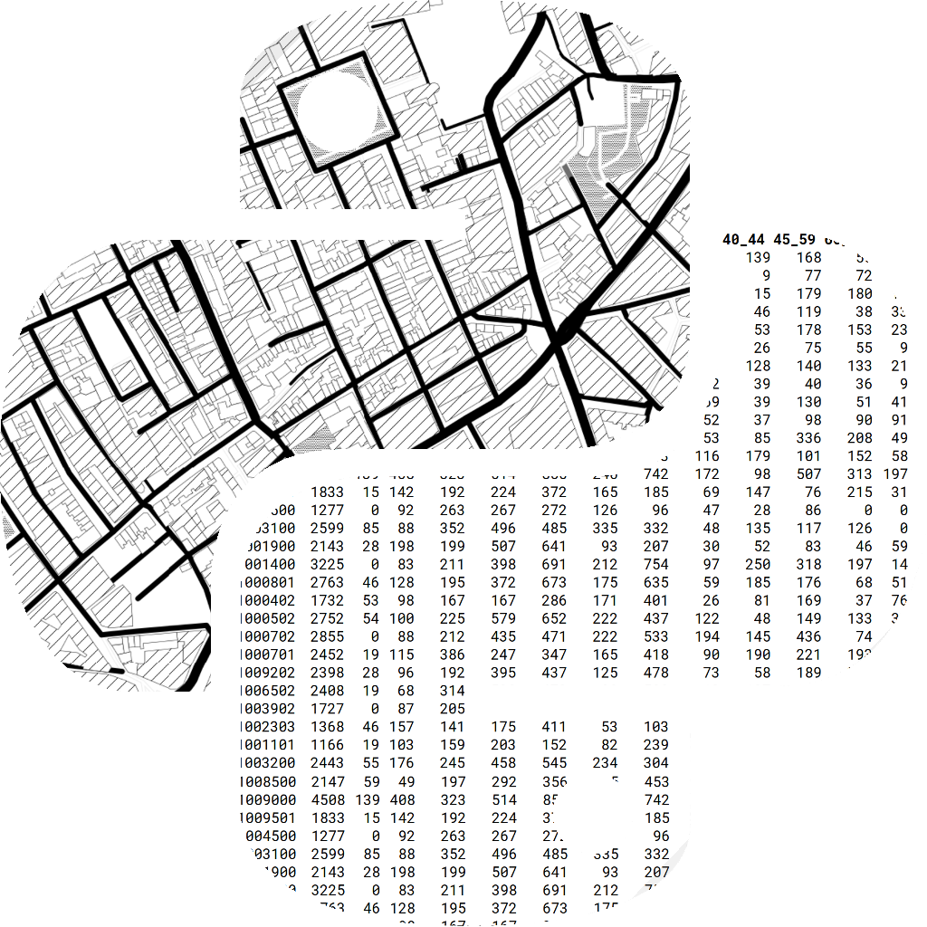
GEOGRAPHIC
DATA SCIENCE
Serge Rey
Dani Arribas-Bel
Levi John Wolf
Methods & models that do (un)supervised learning with Python using PySAL & Scikit-Learn. CRC Press, 2022.
geographicdata.science/book

Slide 28
GEOGRAPHIC DATA SCIENCE
COMMODITY:
Do standard analysis on your standard data
& chuck the results into Tableau/Alteryx to map
ENRICHED:
Do standard analysis on data after you have
augmented it using spatial feature engineering
EXTENDED:
Use methods that explicitly learn from, analyze,
or summarize the geographical structure in your data

Slide 29
GEOGRAPHIC DATA SCIENCE
COMMODITY:
Do standard analysis on your standard data
& chuck the results into Tableau/Alteryx to map
ENRICHED:
Do standard analysis on data after you have
augmented it using spatial feature engineering
EXTENDED:
Use methods that explicitly learn from, analyze,
or summarize the geographical structure in your data

Slide 30
COMMODITY:
Do standard analysis on your standard data
& chuck the results into Tableau/Alteryx to map
ENRICHED:
Do standard analysis on data after you have
augmented it using spatial feature engineering
EXTENDED:
Use methods that explicitly learn from, analyze,
or summarize the geographical structure in your data
https://geographicdata.science/book

Slide 31
COMMODITY:
Do standard analysis on your standard data
& chuck the results into Tableau/Alteryx to map
ENRICHED:
Do standard analysis on data after you have
augmented it using spatial feature engineering
EXTENDED:
Use methods that explicitly learn from, analyze,
or summarize the geographical structure in your data
https://geographicdata.science/book

Slide 32
GEOGRAPHICDATA.SCIENCE/BOOK
ENRICHED:
Do standard analysis on data after you have
augmented it using spatial feature engineering
https://geographicdata.science/book

Slide 33
GEOGRAPHICDATA.SCIENCE/BOOK
ENRICHED:
Do standard analysis on data after you have
augmented it using spatial feature engineering
https://geographicdata.science/book
synthesizing information using spatial relationships within or across data.

Slide 34
GEOGRAPHICDATA.SCIENCE/BOOK
ENRICHED:
Do standard analysis on data after you have
augmented it using spatial feature engineering
https://geographicdata.science/book
synthesizing information using spatial relationships within or across data.
connecting datasets together using map matching
expressing latent structure using map synthesis

Slide 35
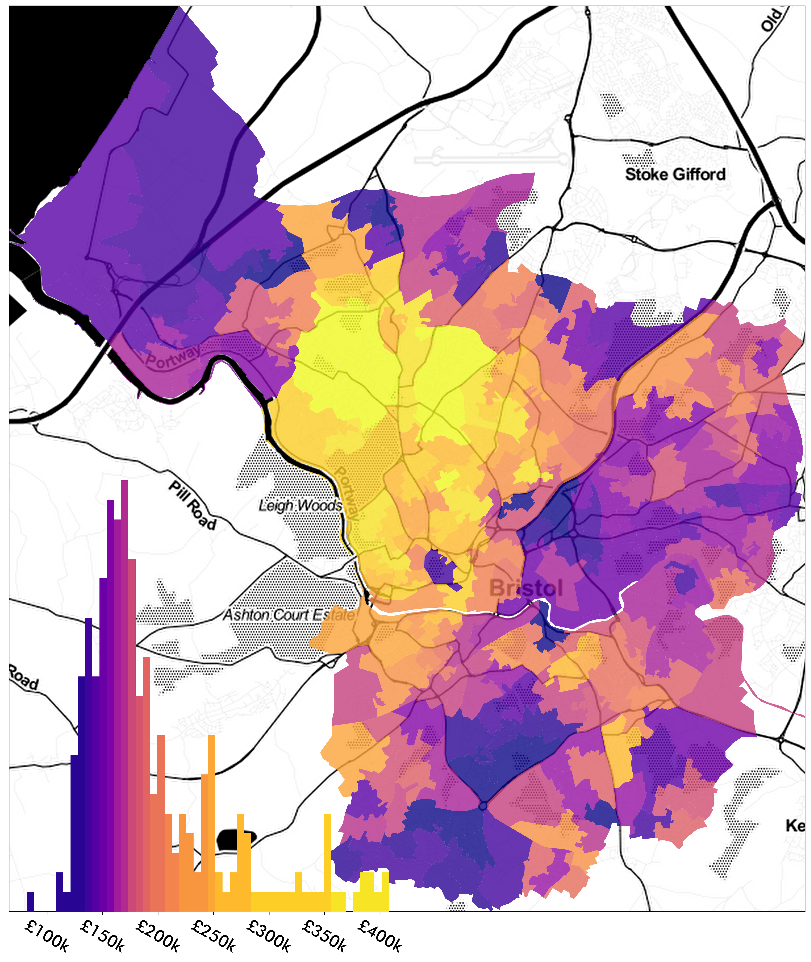
GEOGRAPHICDATA.SCIENCE/BOOK
https://geographicdata.science/book
Say you’re modelling house prices
How good are the schools in the area?
How far is my nearest park?
Is the architecture in the area pretty?
Are there good views?
What’s the air quality like?

Slide 36
GEOGRAPHICDATA.SCIENCE/BOOK
https://geographicdata.science/book
Say you’re modelling house prices
How good are the schools in the area?
How far is my nearest park?
Is the architecture in the area pretty?
Are there good views?
What’s the air quality like?
MAP MATCHING
Using spatial relationships to transfer information to your target data

Slide 37
GEOGRAPHICDATA.SCIENCE/BOOK
https://geographicdata.science/book
Say you’re modelling house prices
How much are nearby houses?
How many bedrooms are typical here?
Is it larger than nearby alternatives?
Does any house near have a garden too?

Slide 38
GEOGRAPHICDATA.SCIENCE/BOOK
https://geographicdata.science/book
Say you’re modelling house prices
How much are nearby houses?
How many bedrooms are typical here?
Is it larger than nearby alternatives?
Does any house near have a garden too?
MAP SYNTHESIS
Using spatial relationships between observations to synthesize new features

Slide 39
PYTHON FOR
GEOGRAPHIC
DATA ANALYSIS
Henrikki Tenkanen
Vuokko Heikinheimo
David Whipp
Solving Geographic Information Processing problems
with high-performance Python. CRC Press, 202X.
pythongis.org

Slide 40
GEOGRAPHIC
DATA SCIENCE
Serge Rey
Dani Arribas-Bel
Levi John Wolf
Methods & models that do (un)supervised learning with Python using PySAL & Scikit-Learn. CRC Press, 2022.
geographicdata.science/book

Slide 41
CONCEPTS COMPUTATION

Slide 42
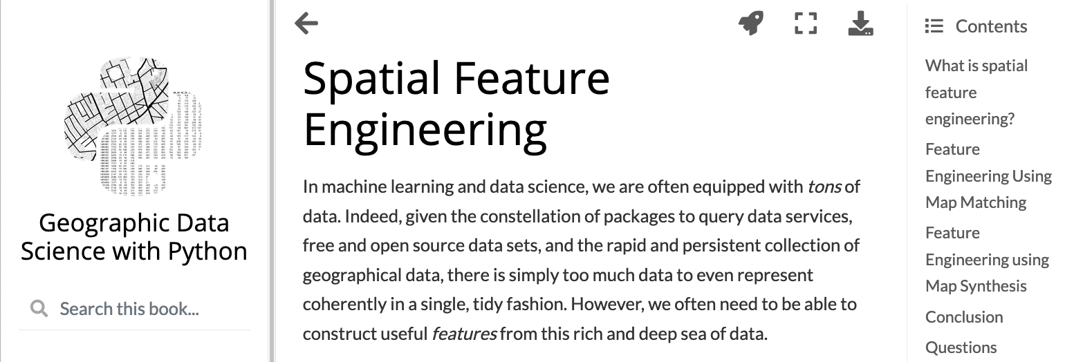
https://bit.ly/3dLDEha

